Slide 1
Welcome Soon-to-be 3rd Graders!
You are going to love being a Wylie Voyager!

Slide 2
We believe you will love Wylie!

Slide 3
10 Great Things about…

Slide 4
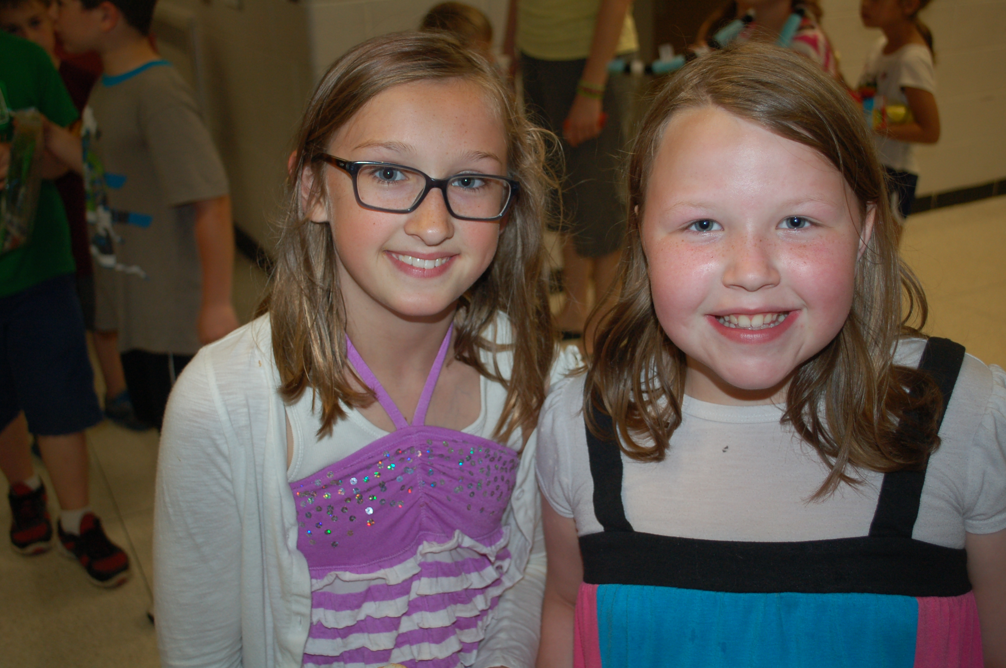
Wylie students are nice, and you make new friends!

Slide 5
Wylie teachers and staff are awesome!

Slide 6
We have fun assemblies!

Slide 7
Wylie’s playground is fun!

Slide 8
We love our Wylie Specials!

Slide 9
Learning is interesting and cool!

Slide 10
Students lead our morning announcements.

Slide 11
Anti-Bullying Club (ABC) helps keep Wylie safe.

Slide 12
We have fascinating field trips!

Slide 13
Wylie Warnival is tons of fun!

Slide 14
YOU! You will make Wylie even better!

Slide 15
We believe you are going to have a …

